Slide 1
NCA Sponsored Training
Day 1 – Morning Session (Lab)
Shell 101 & File Analysis
Presenter Name
City
February 2025

Slide 2
Outline
Introduction to Unix-based OS
What is Linux
How to interact with the OS
The Unix Shell
Introduction
Basic Commands
3. File Signature
What is File Signature
How to identify File Signature
4. Metadata Analysis
What is Metadata
Analyze image metadata

Slide 3
Linux Operating System

Slide 4
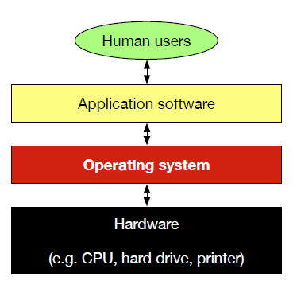
What is Linux?
Linux is an Operating System (OS)
Software that manages the computer's hardware and provides common services for software (read keyboard input, draw window on screen, etc.)
Include useful software utilities (compiler, text editor, etc.)

Slide 5
What is Linux?
The Linux OS is a combination of:
Linux kernel
Provides core OS functionality (e.g. process and hardware management)
Multitasking and multiuser, advanced security
Open source, created by Linus Torvalds at the University of Helsinki in 1991
GNU's Not Unix (GNU) system software
Open-source software project started in 1983 by Richard Stallman at MIT
Intended to become its own OS but the kernel (HURD) isn't ready yet
Includes glibc C library, libstdc++ C++ library, gcc C/C++ compiler, gdb debugger, coreutils, binutils, bash shell, GNOME desktop env., Emacs text editor, etc

Slide 6
Interacting with the operating system
Graphically
Graphical primitives such as windows, icons and buttons
Common window managers: KDE, GNOME, MATE (GNOME fork), XFCE
Textually (our focus today)
Through a command-line interpreter or shell
Very powerful, can actually be seen as a programming language
Can run inside a graphical window (terminal emulator)
Common Unix shells conforming to the POSIX standard: bash, dash, csh

Slide 7
Getting Help With Commands
Exercise
The uname program can be used to obtain system information
Use man to figure out how to use uname to obtain:
The operating system of the computer you are working on
The kernel release of your Linux OS
Use uname for the aforementioned purposes
Notes:
uname -o –r

Slide 8
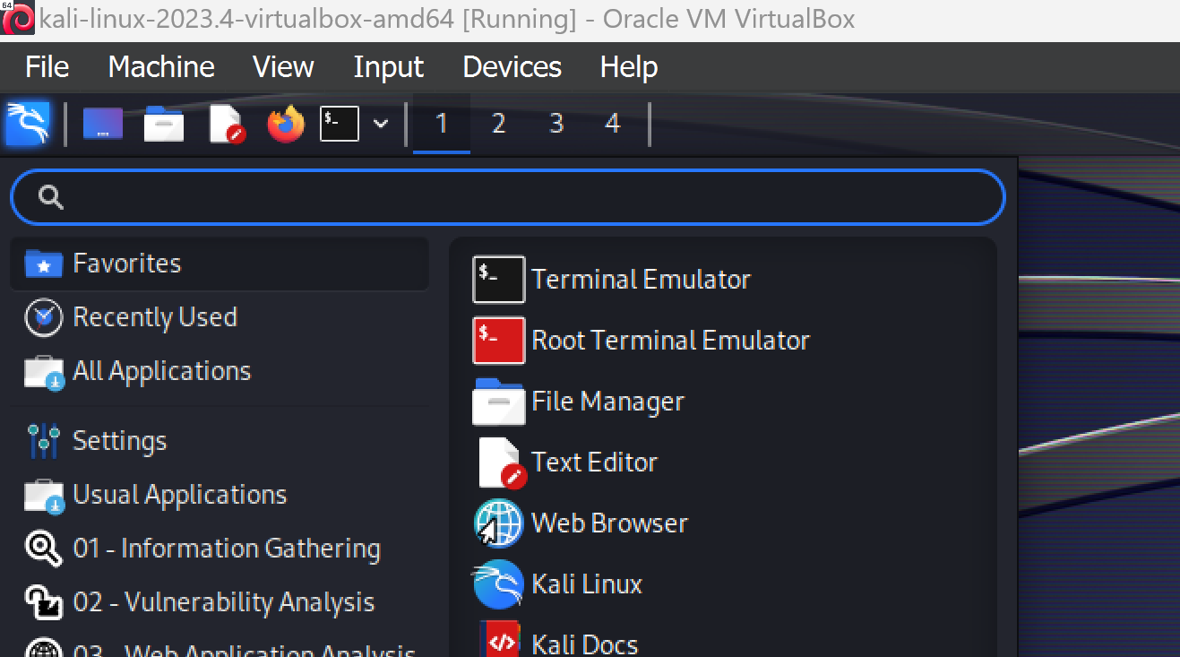
Our First Command
Open up a terminal emulator:

Slide 9
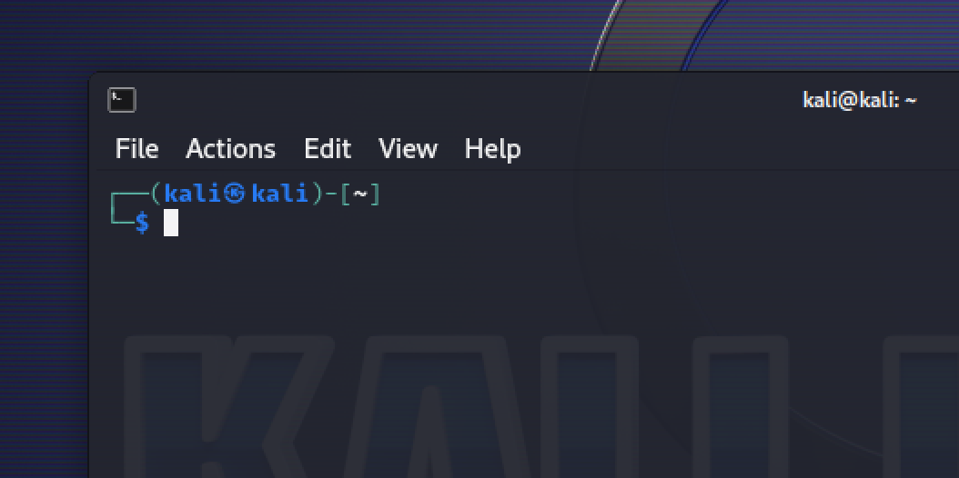
Our First Command
The Shell is waiting for a command
Type echo Hello World and hit the Enter key
What happened?
Prompt
Your Command Here

Slide 10
Our First Command
What happened?
The command was executed, yielding the writing of Hello World onto the terminal window
A prompt is displayed, allowing us to enter a new command
The echo program writes its arguments to the standard output
(which is, by default, the terminal) and a new line

Slide 11
Anatomy of a Command
ls –l –a /home/kali
executable
options
arguments
Different programs support different options and arguments

Slide 12
Getting Help With Commands
Every GNU program has an associated manual page
The command man <program-name> lets us access it
Navigating a manual page
We can use the navigation keys (e.g. arrow keys) to move around
We can search by hitting /, typing in your query and hitting entry
To navigate multiple hits we can use n for next and Shift+n for previous
Finally, we can exit the manual by hitting q

Slide 13
Navigating command history
Retyping entire commands can be cumbersome
We can use the up and down keys to recall previous commands
Exercise:
Experiment with your command history, search for the echo Hello World command

Slide 14
Some Important Things
~ = My Home Directory
clear = Clear the terminal
echo = Print something on the screen
[TAB] = Auto-complete commands

Slide 15
Linux Filesystem

Slide 16
Linux Filesystem
cd – change directory
pwd - print name of current/working directory
ls - list directory contents
touch <path> - will create an empty file <path>
nano <path> - is a user-friendly terminal-based text editor
mkdir <path> - creates new empty folder <path>
cat <path> - prints entire to the standard output, bad for large files
less <path> - prints a single screen's worth, then pauses

Slide 17
Filesystem Exercises
Create a folder named scripts inside your home folder
Create a file named hello.sh inside the scripts folder
Edit it using a text editor so that it contains the following two lines:
#!/bin/bash
echo "Hello world!"
Print hello.sh's contents to the standard output

Slide 18
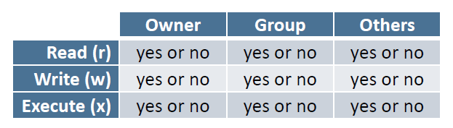
File Permissions
Unix has built-in file security. Every file has these permissions
We can list the permissions of a given file using ls -l

Slide 19
File Permissions
chmod <opt> <perm> <p1> … <pn> - changes permissions
perm is the permissions string. It is highly flexible
Example:
chmod u=rwx,g=rx,o= hello.sh gives, on file hello.sh, all permissions to owner, read and execute permissions to group and none to others
chmod +x hello.sh gives execute permission to everyone
chmod -x hello.sh removes execute permission for everyone

Slide 20
File Execution
The shell only looks for executables in your the folders specified in the PATH environment variable
With the prefix ./ you can execute a file that is not in your PATH but in your working directory. For executables located elsewhere we need a complete (absolute or relative) path
Exercise:
Give execution permissions to our hello script
Run our hello script

Slide 21
Linux Filesystem
rm <path1> – removes regular files
mv <path1> … <pathn> <dst> - move files to dst (cut and paste)
cp <path1> … <pathn> <dst> - copy files to dst (copy and paste)

Slide 22
Redirection
Most programs read from the standard input (keyboard) and write to the standard output (terminal). We can use redirection to alter that behavior.
Redirecting output with > and >>
redirect echo's output to a file, overwriting existing contents (if any)
echo "Hello hello hello" > file.txt
append echo's output to a file (preserves existing contents)
echo ”how low" >> file.txt

Slide 23
File Signatures & Metadata Analysis

Slide 24
File Signatures & Metadata Analysis
In digital forensics, identifying and analyzing files accurately is important for investigations. Attackers often change file extensions to trick users and security systems into opening malicious files, often disguising malware as harmless documents or images. By embedding hidden metadata, they can store malicious code, conceal their true intentions, or manipulate how security tools interpret the file, enabling them to bypass detection and execute attacks unnoticed.

Slide 25
File Signatures & Metadata Analysis
In this lab series, we will explore two fundamental techniques used in forensic analysis:
File Signatures & Magic Numbers: Understanding how files are identified by their internal structure, rather than relying on extensions.
ExifTool for Metadata Analysis: Extracting detailed metadata from files, which can reveal information like timestamps, modification Dtae, details, and hidden data.
By mastering these techniques, you will develop essential skills for identifying file tampering, uncovering hidden data, and verifying file authenticity which is critical for forensic investigations.
Let’s dive in!

Slide 26
File Signature

Slide 27
File Signature
In this lab, you will learn how to identify files based on their file signatures (magic numbers) rather than their extensions. This technique is useful in digital forensics, cybersecurity, and file integrity verification.
A file signature (or magic number) is a unique sequence of bytes at the beginning of a file that identifies its format.
Unlike file extensions (e.g., .jpg, .png, .pdf), file signatures are more reliable because they are stored within the file itself.
Attackers sometimes disguise files by changing extensions, but the file signature remains unchanged.

Slide 28
Install xxd tool
xxd is a command-line tool used to create a hex dump of a file. The tool is usually pre-installed in Kali Linux as part of the vim-common package. However, if it is missing, you can install it using the following command:
sudo apt install xxd -y
We will be using xxd tool to get the file signature
(first bytes in the file hex representation)

Slide 29
Identifying File Signatures
Open a terminal and navigate to the directory containing the files to analyze.
Use the xxd command to view the first few bytes (16 bits) of a file in hexadecimal format:
xxd -l 16 <filename>
Example
xxd -l 16 kaust_monument.png

Slide 30
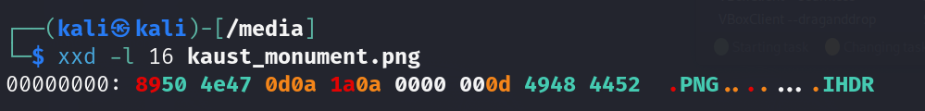
Identifying File Signatures
The signature 89 50 4e 47 (.PNG) confirms that this is a PNG file
This website is great resource to get the file type by its signature, you can use the search in page utility to get the type faster:
https://www.garykessler.net/library/file_sigs.html

Slide 31
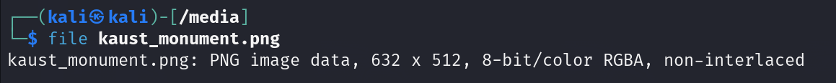
Identifying File Signatures
Instead of manually checking the file signature, we can use the file command:
file <filename>
Example
file kaust_monument.png

Slide 32
File Signatures
What is a file signature, and why is it important?
How can you verify a file’s type without relying on its extension?
What is the magic number for a PDF file?
If a file has the extension .jpg but contains the signature 25 50 44 46, what does that indicate?
What command would you use to extract only the first 16 bytes of a file in hexadecimal format?

Slide 33
Conclusion
File signatures are a reliable way to identify files, especially when dealing with spoofed extensions or malicious file disguises. Tools like xxd and file help in forensic analysis by detecting mismatches between file extensions and actual content. Understanding file signatures is crucial in malware analysis, incident response, and Digital Forensic.

Slide 34
Metadata Analysis

Slide 35

Metadata and ExifTool
Metadata is an extra information stored within a file that describes its properties, such as the author, creation date, camera settings (for images), and more. This data is useful for digital forensics, cybersecurity, and photography.
ExifTool is a command-line Tool used to read, write, and edit metadata in various file formats, including images, PDFs, videos, and documents.
ExifTool is Available in kali, no need to install it.

Slide 36
Manual Utility
As we discussed earlier, and to understand how to use any tool, check its manual using:
man exiftool
This will display:
A description of ExifTool
File types it supports
Metadata fields it can extract
Options & commands for different outputs
It’s always a good practice to read the documentation or manual of any tool before using it. Press 'q' to exit the manual.

Slide 37
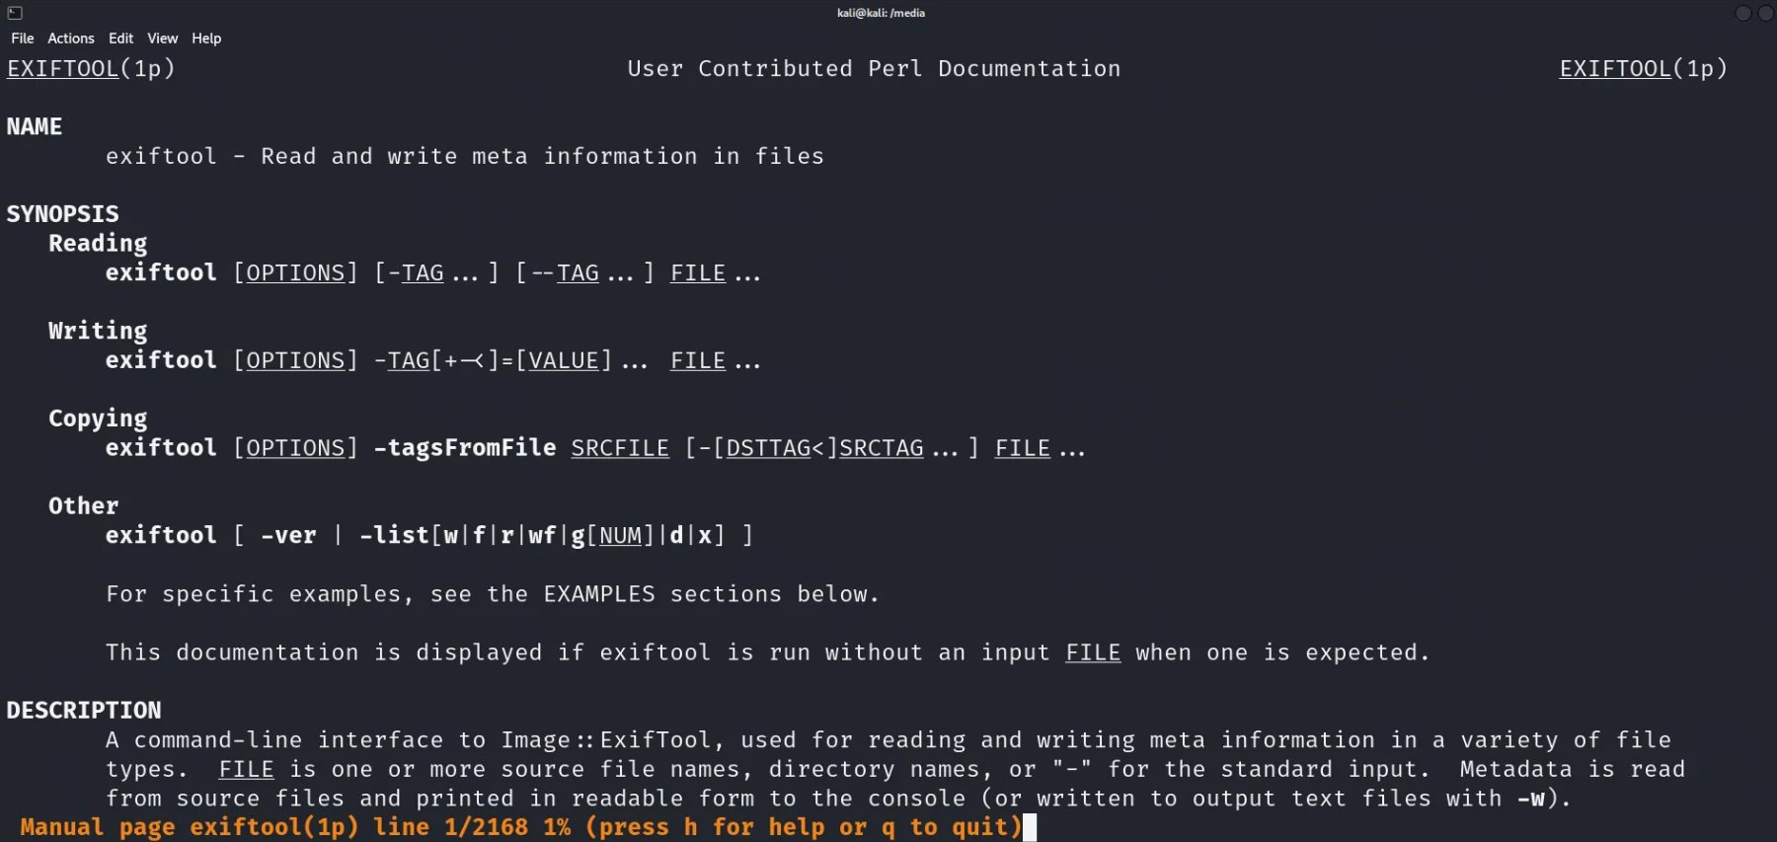
Manual Utility

Slide 38
Using ExifTool to Analyze Image Metadata
Navigate to the Directory:
Before using ExifTool, navigate to the folder containing the file you want to analyze. You can use the following commands that we learned earlier:
Change directory
cd <directory path>
List files in the current directory:
ls
Check your current working directory:
pwd

Slide 39
Using ExifTool to Analyze Image Metadata
Run ExifTool to Extract Metadata
Once you're in the correct directory, use this simple command:
exiftool <file name>
This basic command will display metadata stored in the media file
Example: Analyzing an Image File
for example, analyzing the kaust monument image using ExifTool:
exiftool kaust_monument.png

Slide 40
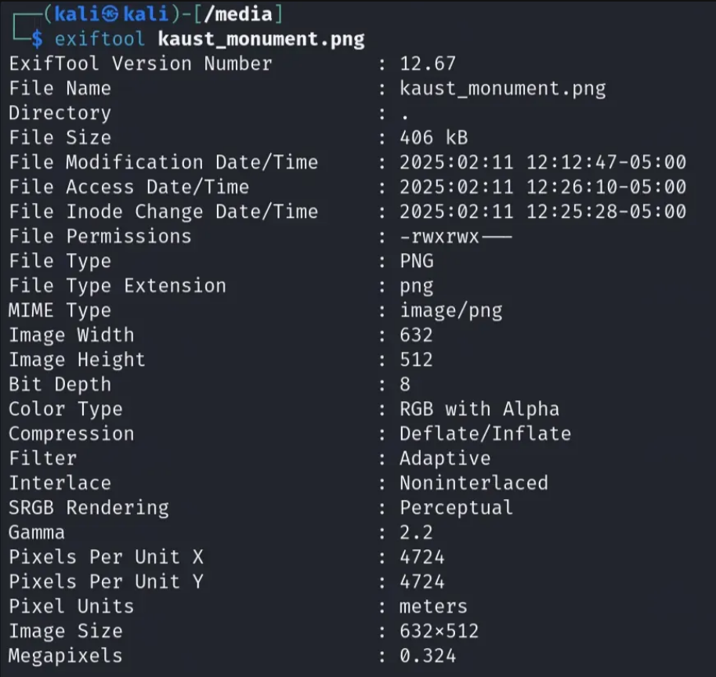
Using ExifTool to Analyze Image Metadata
This metadata tells us:
The file is a PNG image (632×512 pixels, 0.324 MP, 8-bit depth, RGB with transparency).
The file was last modified on February 11, 2025, at 12:12 PM (-05:00 timezone).
The "-05:00" indicates the timezone, meaning this timestamp follows a time zone that is 5 hours behind UTC.
This is useful in digital forensics and file tracking to determine when an image was edited or created.

Slide 41
Using ExifTool to Analyze Image Metadata
This metadata tells us:
It has specific compression and rendering settings for optimal display.
The file permissions indicate that only the owner and group can read, write, and execute the file, shown ine The file Linux-style permissions: -rwxrwx--- , which break down as:
Owner (rwx) → Can read (r), write (w), and execute (x) the file.
Group (rwx) → Members of the file’s group can also read, write, and execute the file.
Others (--) → No permissions; users outside the group cannot access the file.

Slide 42
Using ExifTool to Analyze Image Metadata
Now try to analyze the other image and answer the following questions:
What is the file name of the image?
What is the file format of the image?
When was the file last modified?
What are the file permissions of this image? What do they mean?

Slide 43
Using ExifTool to Analyze Image Metadata
Exploring ExifTool Options (optional)
Which command can be used to extract only metadata related to the file system (modification time, access time, permissions, etc.)?
Which ExifTool option can be used to display all metadata in a structured JSON format?
How can you filter out only specific metadata fields, such as image dimensions and color type?
How would you extract only the PNG-specific metadata?

Slide 44
Conclusion
Metadata plays a crucial role in file analysis, cybersecurity investigations, and digital forensics. In this lab, we explored ExifTool, a powerful command-line tool for extracting metadata from images and other file types. By analyzing details such as file system information, image properties, color settings, and compression methods, we gained insights into how metadata can be used for various purposes, including authenticity verification, forensic analysis, and security assessments.
While ExifTool is one of the most widely used tools for metadata extraction, there are several other tools available that serve similar purposes. Each tool has its strengths, depending on the type of file being analyzed and the depth of metadata required.

Slide 45

Do you have any questions?

